Slide 1
MDS 560 Session 8

Slide 2
Your Projects Are Due in Your PRIMMS Document Folders
Sunday May 24th 8:00 PM
This is a hard deadline. Don’t make perfection the enemy of the good.
Make sure that you have all of your accelerators submitted by then as well.
Things to keep in mind for your projects.
Show your work especially if models look too good to be true. The Powerpoint document is sufficient as long as it is sufficiently detailed
If models look especially weak, it is expected that you will mention that you tried multiple approaches and feature engineering/segmentation. If you add features, any new variables need to be reflected in the production dataset as well. Be careful in doing that.
There is no penalty for simple models unless key assumptions are violated. Often simplest is best. E.G. boosting is complex; whereas a regression, logistic regression may perform just fine in production. But for consulting assignments random forest and gradient boosting excellent choices.
You can assume that outliers are justified to keep observations even for linear models.
Show validation of performance results.
Show variable importance
Be sure to discuss business implications of your findings. Answer the question “What strategy would you recommend for the business to follow. What changes should the business make to create value?”

Slide 3
Project Questions: Some Considerations
Variable “Exited” Definition: 1=Exited, 0=not Exited
Variable “Is Active Member” Definition: 1=Is Active, 0=Is Not Active (Consider this as meaning customer is an engaged customer who actively participates in bank programs.)
Be sure to show your work. If you show perfect prediction, it will not be accepted at face value. Likewise if you show poor prediction, it needs to be explained.
Feel free to add an Excel sheet for the top 100 most likely churners.
If outlier detection hangs up, you can select one variable at a time or simply plot. Look for obvious mistakes or errors in data entry. But no points will be taken off if you keep all observations.

Slide 4
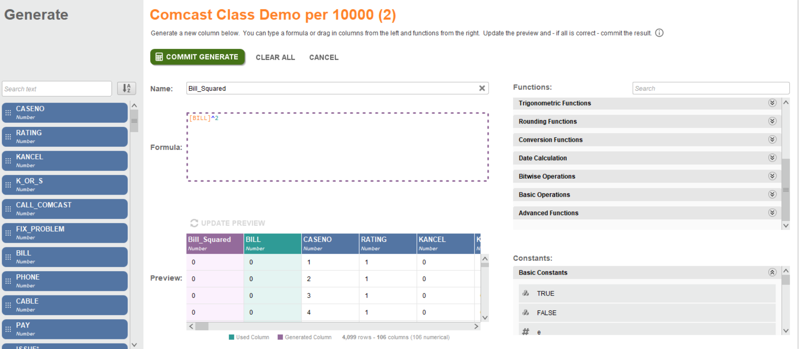
Feature Engineering Example

Slide 5
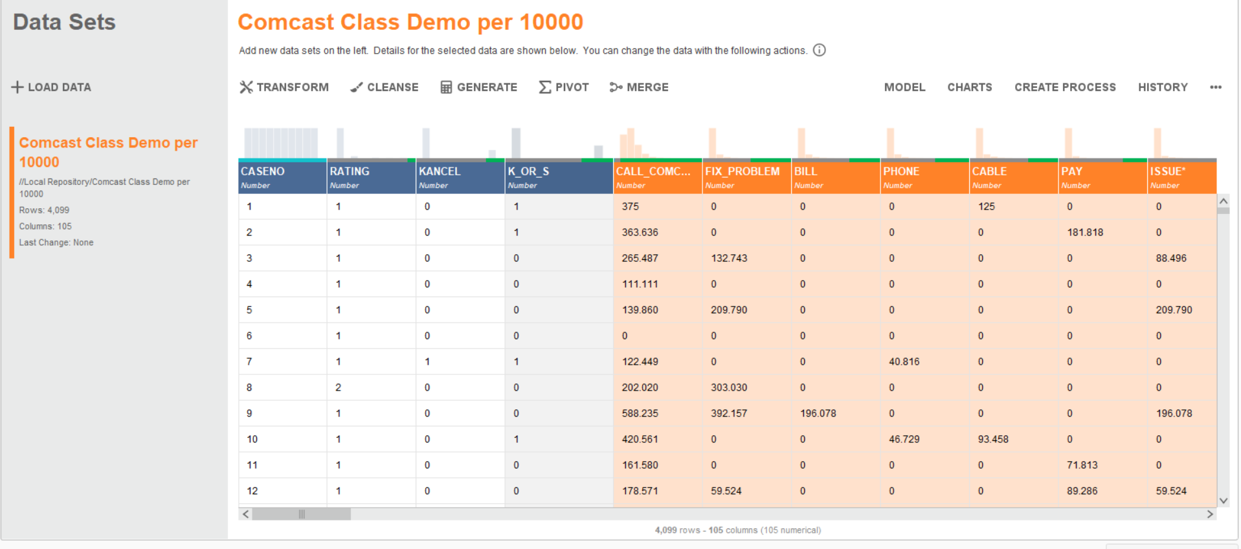
Including PCA in Your Model Example

Slide 6
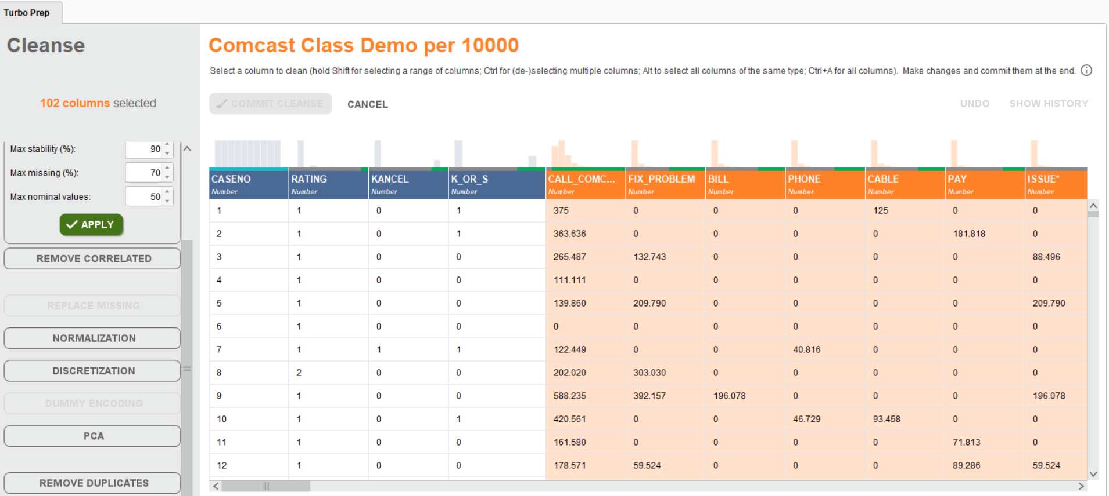

Slide 7
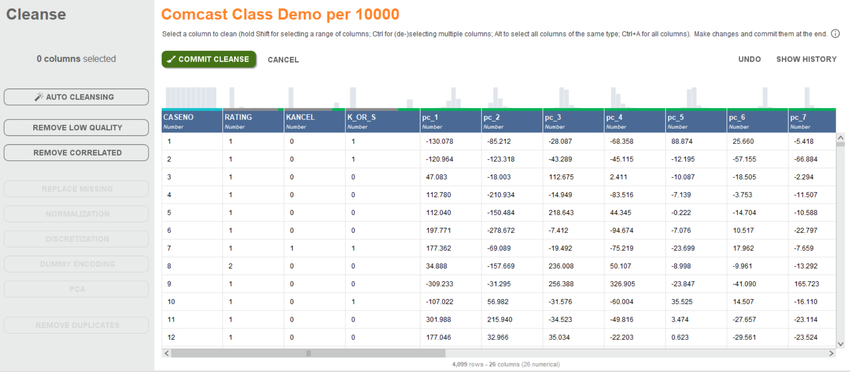

Slide 8
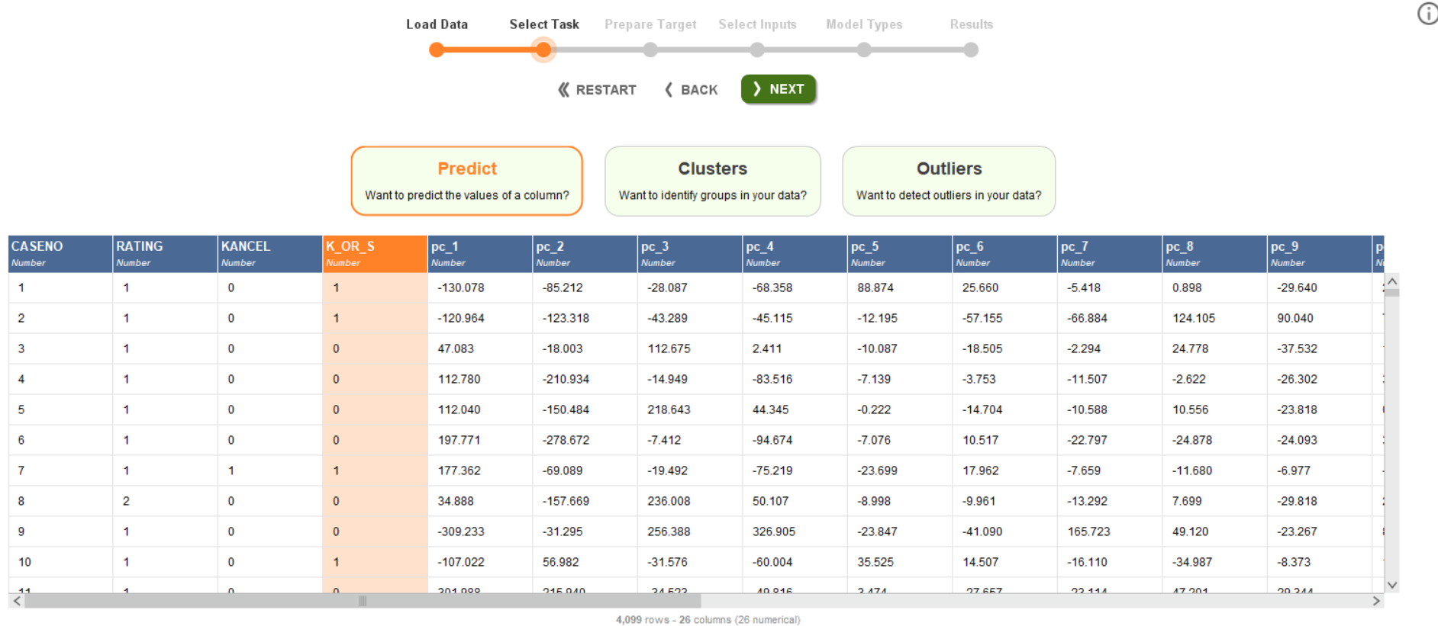
Send to Automodel and select label………

Slide 9
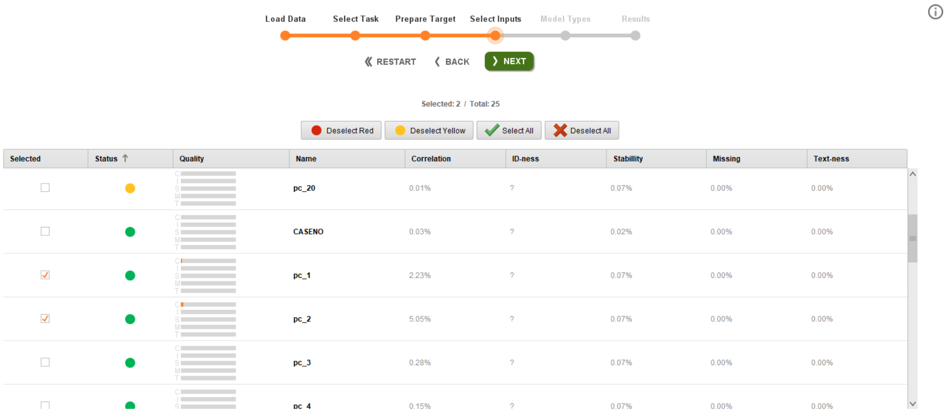
Select only the principle components that you want

Slide 10
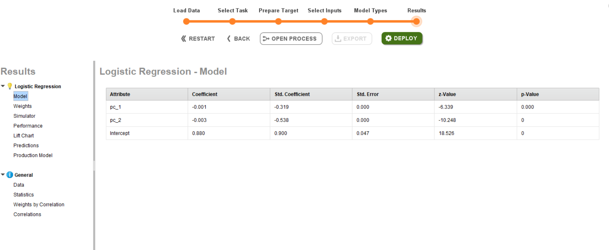
Run the models and analyze

Slide 11
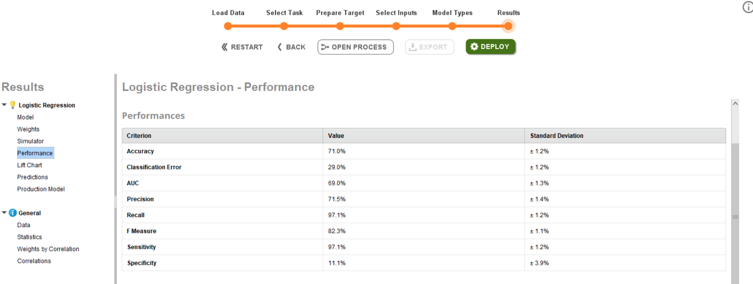

Slide 12
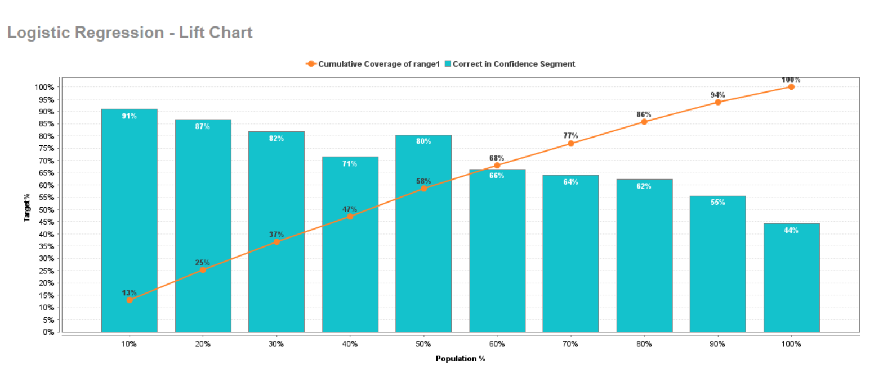

Slide 13
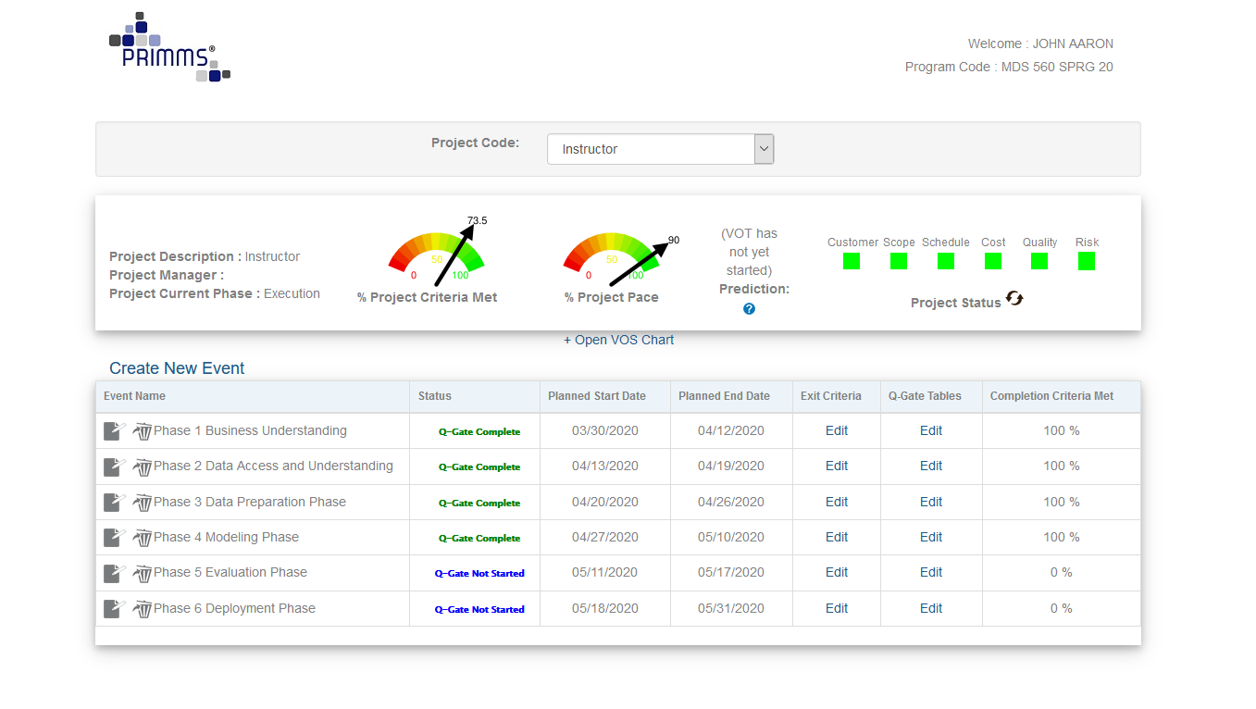
Review of Project Management Assignment From Accelerator

Slide 14
Images as Machine Learning Inputs to Intelligent Automation

Slide 15
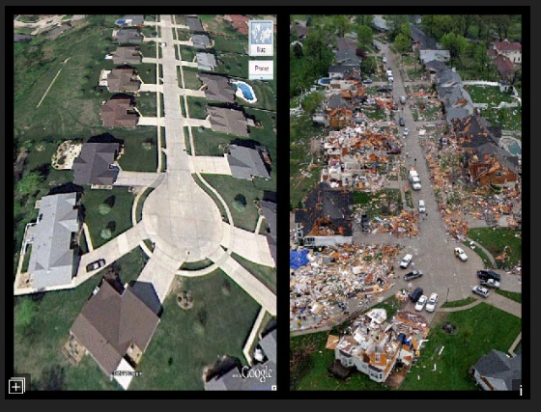
Very Hypothetical Example Using Anomaly Detection: If We Wanted to Automatically Identify Disaster Areas from Satellite Images
Time 1-No Disaster Features
Time 2-Disaster Features
Anomaly Detection is a critical element of the managerial process.

Slide 16
World
Focus
Memory Storage
Physical Signals
Extract Features
N Bit Vectors
Sensors
Based Upon Kanerva’s 1989 model of the organization of the human autonomous system

Slide 17
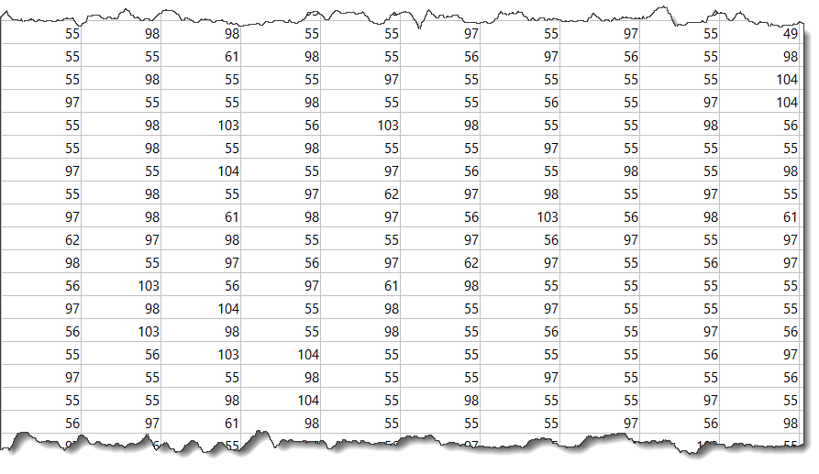
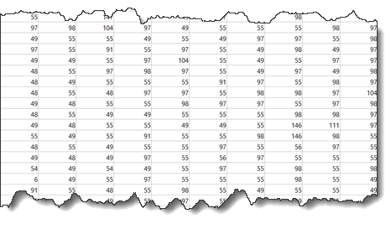
World
Focus
Memory Storage
Training
Physical Signals
Perception Features
N Bit Vectors
Sensors
Classification Memory
Disaster Array (Shown in Part)
No Disaster Array (Shown in Part)
Arrays Converted to Vectors
Based Upon Kanerva’s 1989 model of the organization of the human autonomous system

Slide 18

World
Focus
Memory Storage
Perception-Action Cycle
New Image to Be Classified
Physical Signals
Sensors
PerceptionFeatures
Historical Database
Machine Learning
Methodology
Historical
Data
Class
Prediction
Is it “Disaster” or,
Is it “No Disaster”??
Call for Help
Update
Memory
Motors
Motor Features
Action?
Actions

Slide 19
World
Focus
Memory Storage
New Image to Be Classified
Physical Signals
Sensors
PerceptionFeatures
Historical Database
Machine Learning
Methodology
Historical
Data
Class
Prediction
Is it “Disaster” or,
Is it “No Disaster”??
Update
Memory
Motors
Motor Features
Action?
Actions

Slide 20
Our Example is A Bit Far Afield But….
Anomaly Detection is Very Relevant to Process Management
Consider Projects
On track
Vs
Off Track
Before Features
After Features
One record per image is common

Slide 21
Pattern Recognition Is One of the Most Frequently Cited Applications of Machine Learning—Images Are Often Used
Let’s Walk Through a Step By Step Example

Slide 22
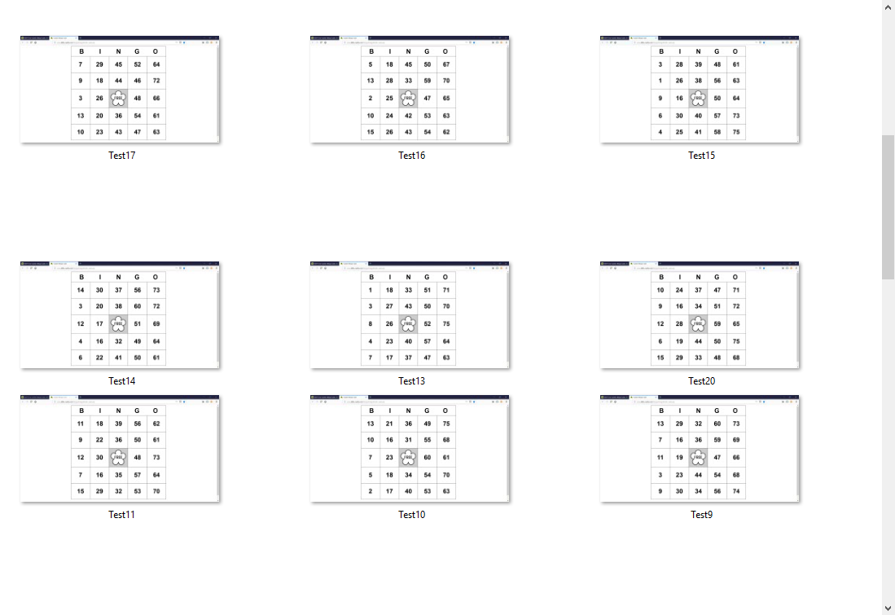
Can We Identify the Bingo Cards That Display the Number 12?
I created 200 Training Examples and 20 Test Examples

Slide 23
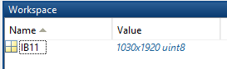
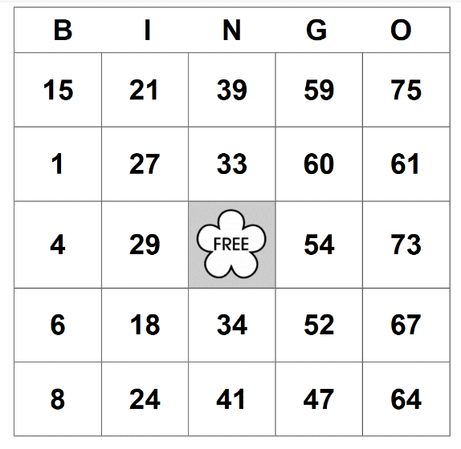
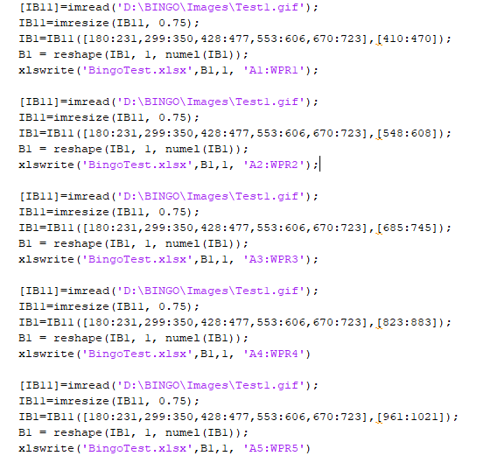
Pre-Processing Steps Performed in MATLAB

Slide 24


Slide 25


Slide 26


Slide 27
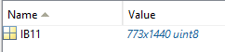

Slide 28
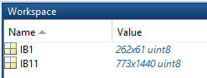

Slide 29


Slide 30
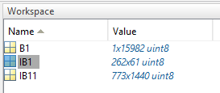

Slide 31
Exported to Excel in Row 1 as a Hyperdimensional Vector

Slide 32
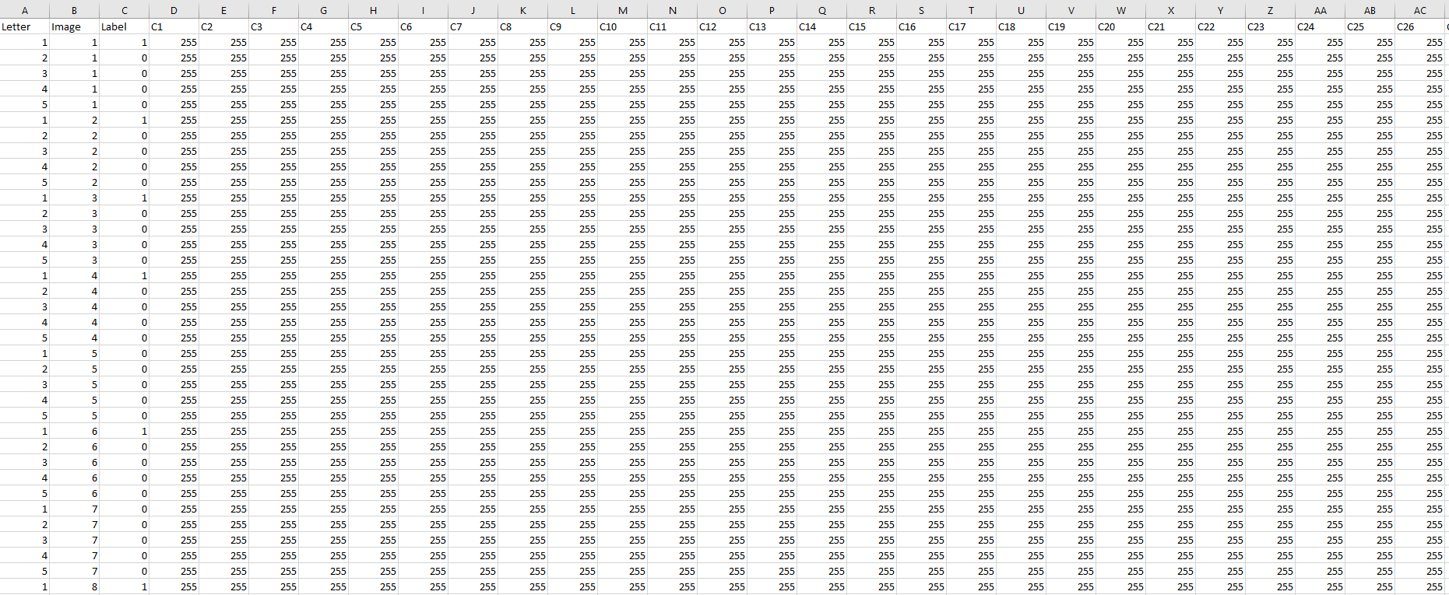
Image Arrays Are Row Vectors (1 by 15,982)
Each Bingo Card Put Into Five Separate Images Showing a Column
Label= 1 if 12 shown on image, else=0

Slide 33
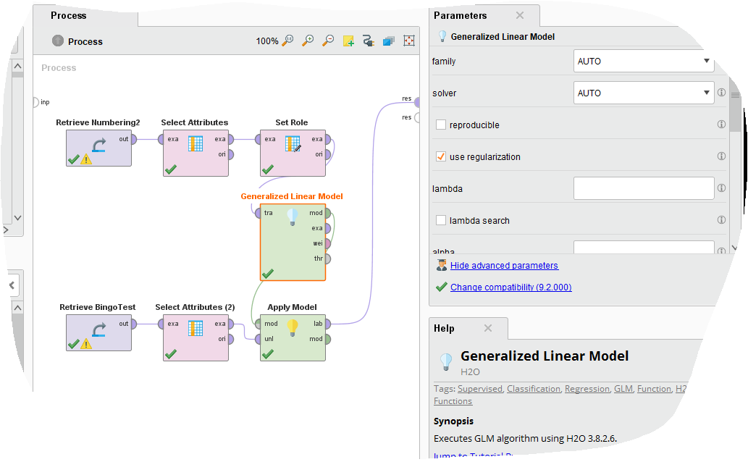

Slide 34
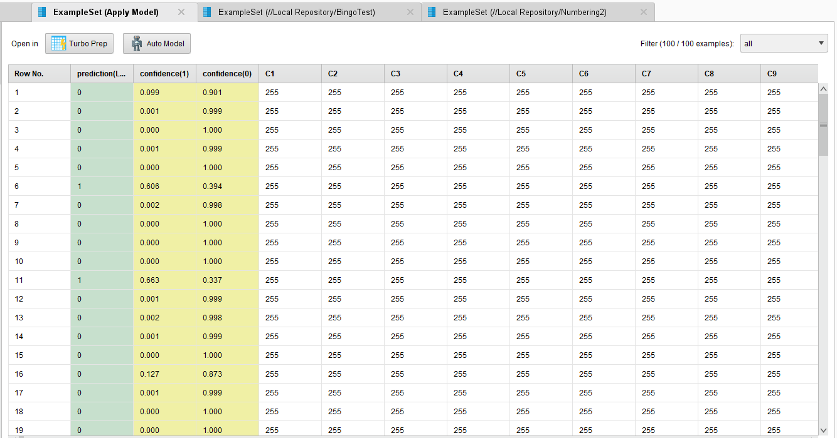

Slide 35
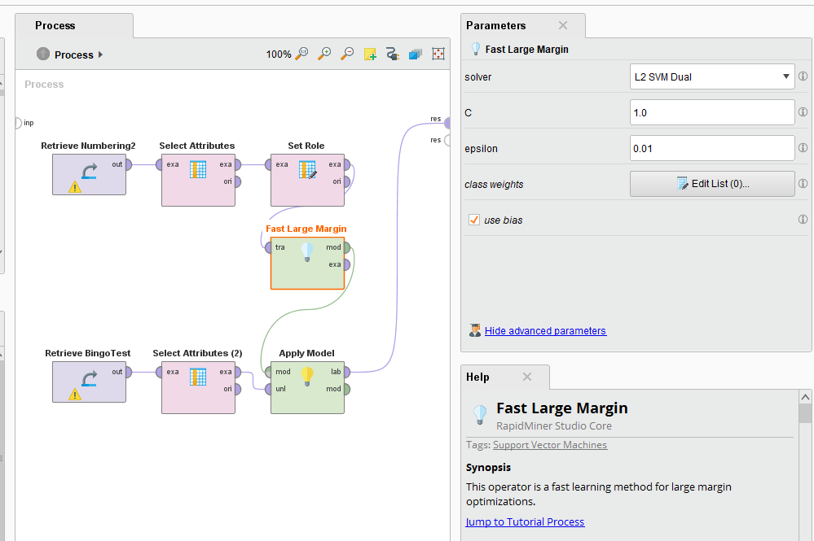
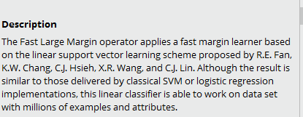
The algorithm performs remarkably well very large datasets like this one.
That said, GLM performed equally well.
A critical consideration is the cost of deployment.

Slide 36
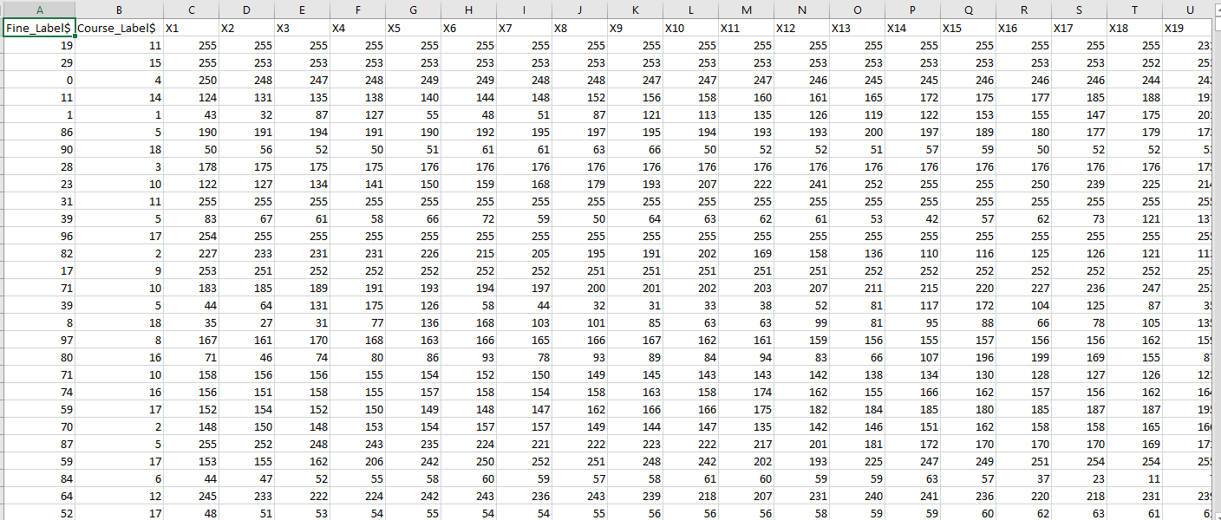
Dataset of Animal Images
Each Row Represents One Image
20 kinds of animals

Slide 37
Automated Systems

Slide 38
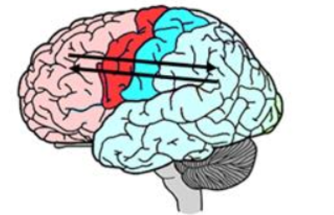
AI Mimics Biology
Reinforcement Learning
(Primarily
Simulation)
Adjust Future Actions
Pattern Recognition
Machine Learning (Actual Data)
Decisions
Action
Toward
a Goal
Our Focus in 560 and 561
Perception
Rewards
Touch
Smell
Taste
Vision
Audition
Outcomes

Slide 39
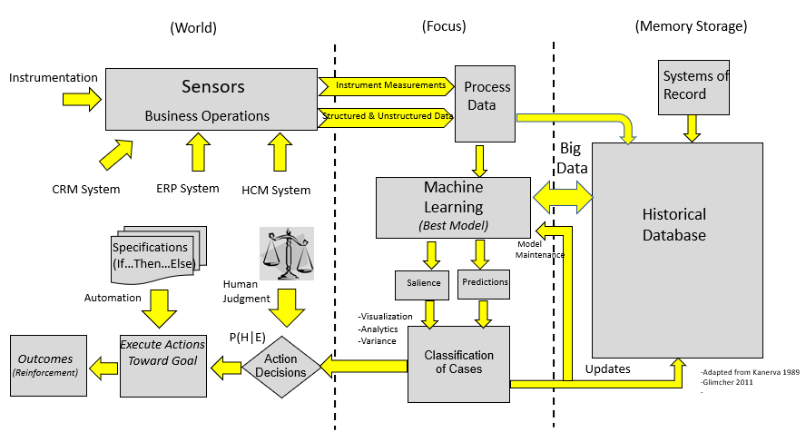
Perception-Action Cycle
A Block Diagram of a System of Intelligence For Enterprise Processes
The Complete Perception-Action Cycle of AI

Slide 40
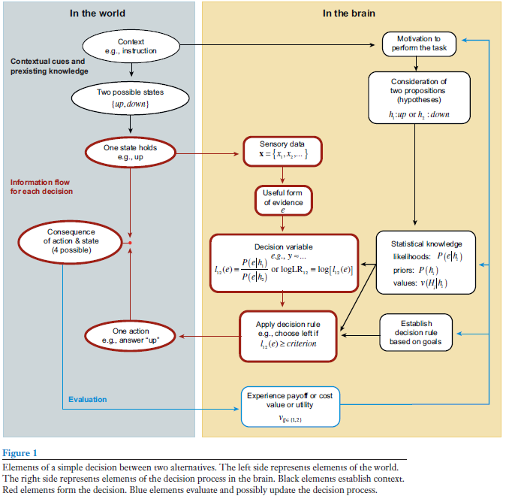


Neuro-Scientists such as Glimcher (2011) and Gold/Shadlen (2007).
AI Feedback Enables The User to Update His/Her Beliefs Rationally Following the Rules of Probability and Expected Value By Presenting Evidence Tied To History.

Slide 41
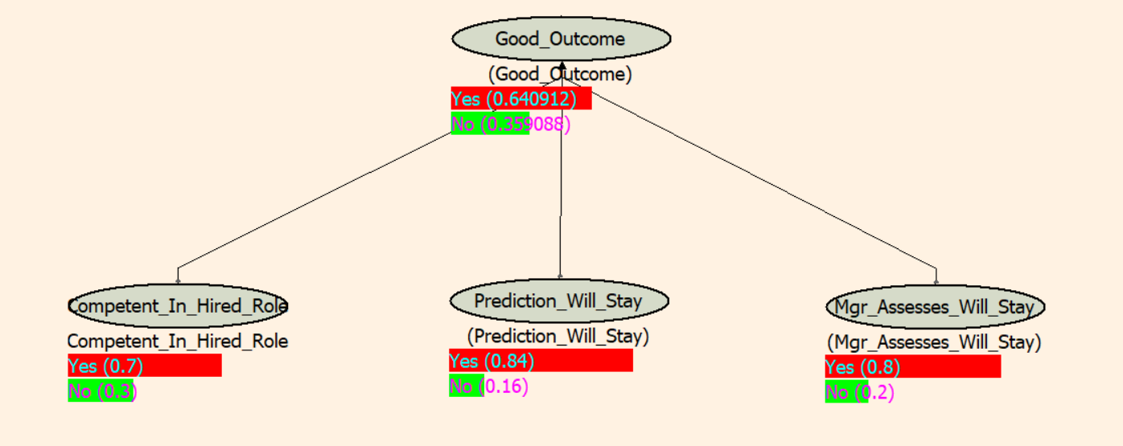
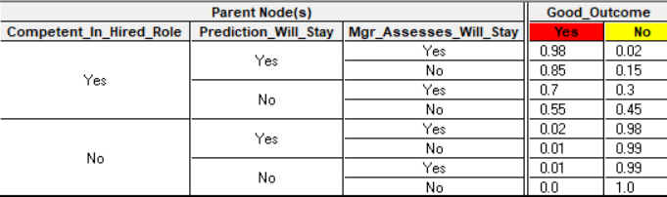
Updating Beliefs Given Evidence--- A Quick Illustration of Hiring an Employee
No Current Evidence—Just General History and Personal Judgment

Slide 42
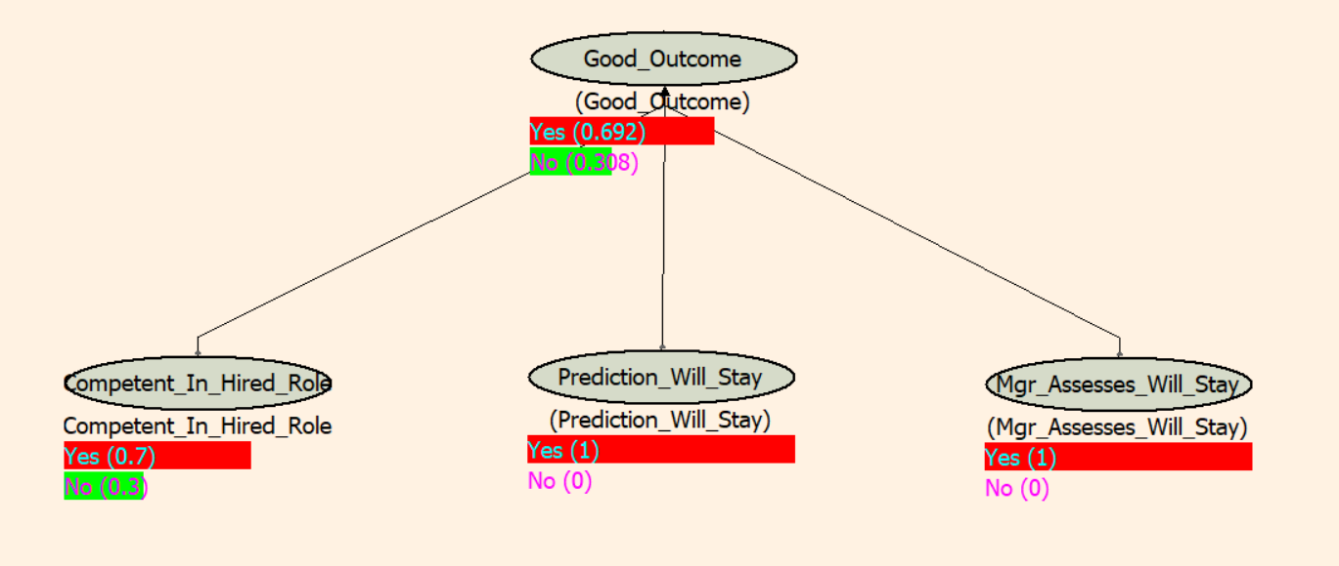
Updating Beliefs Given Evidence--- Continued
From Machine Learning Classification
Machine Learning Prediction and Managerial Interview Agree that Employee Will Stay

Slide 43
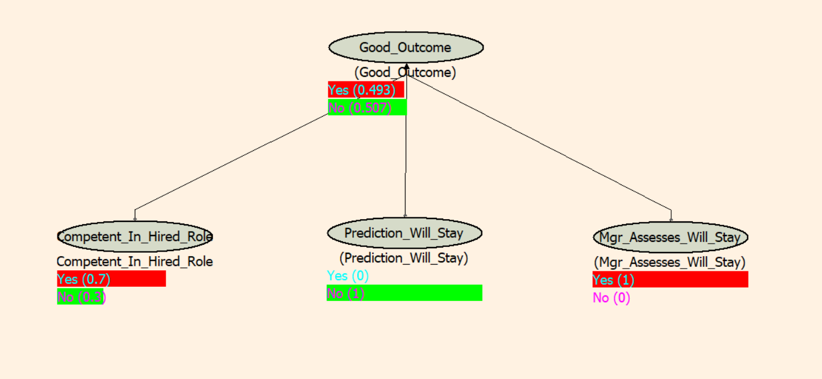
Updating Beliefs Given Evidence--- Continued
The Machine Learning Prediction Causes the Manager to Rethink About Hiring the Candidate
From Machine Learning Classification
The ML Prediction May Consider Many, Many Factors
Machine Learning Prediction and Managerial Interview Evidence Disagree

Slide 44
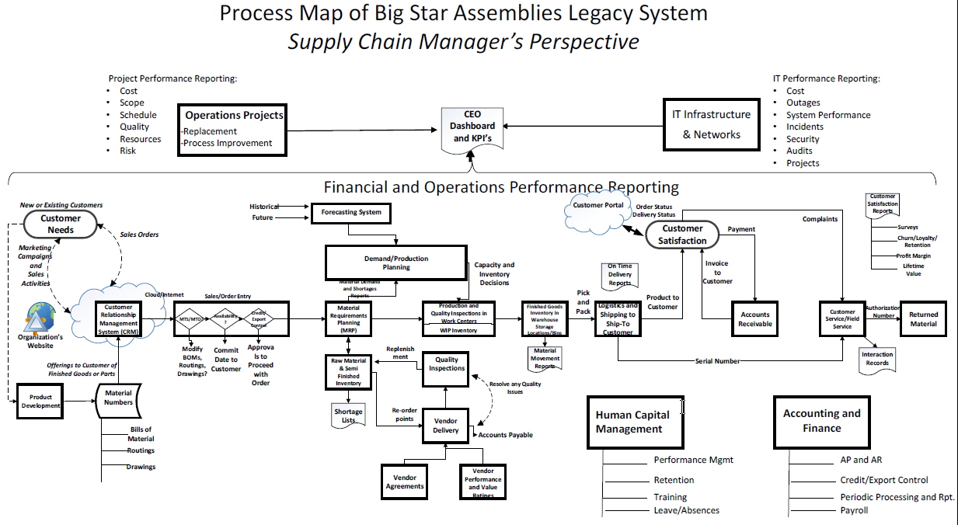

Slide 45
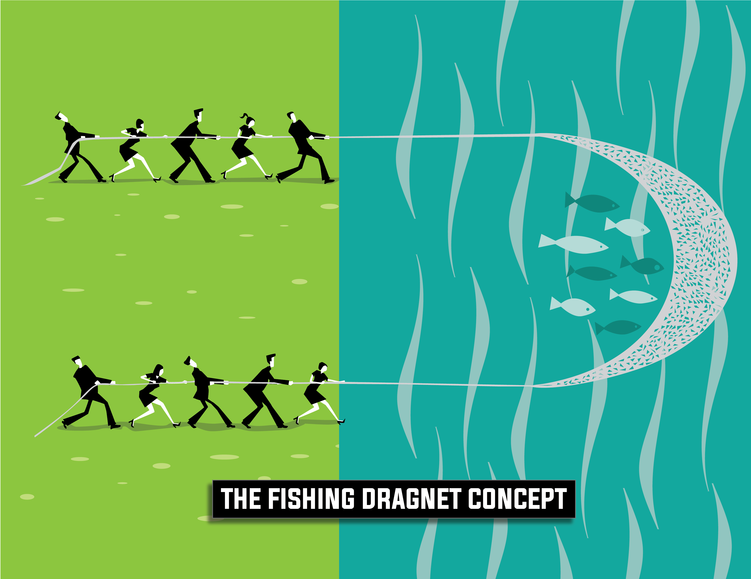
The Intake Process Begins With Management Communication

Slide 46
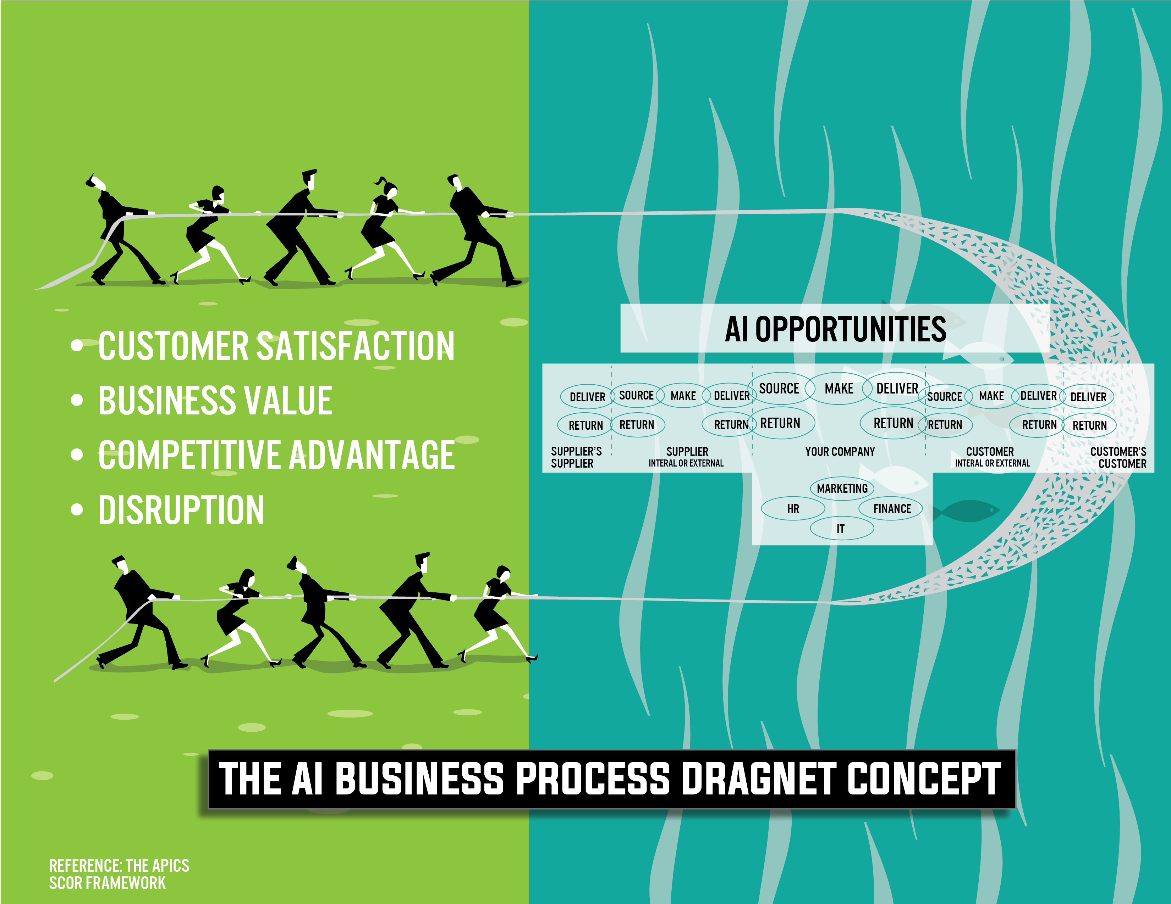

Slide 47
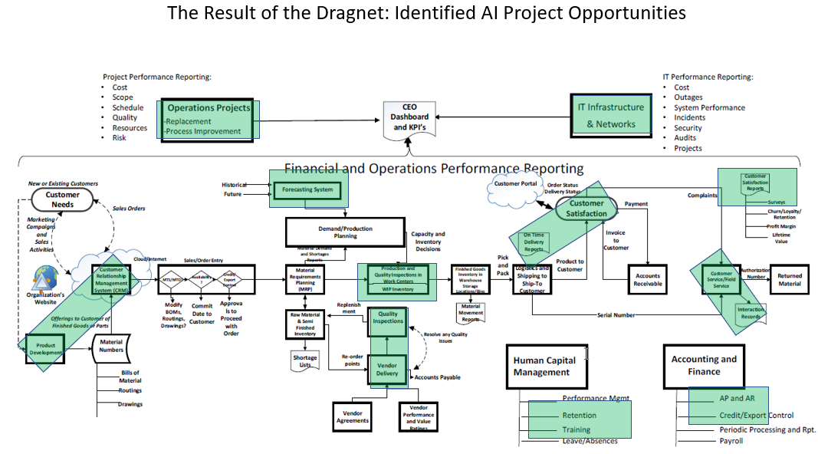

Slide 48
AI and Predictive Analytics
Machine intelligence is a “prediction” technology.
The cost of prediction is falling.
The value of things that complement prediction will rise, (Example: data collection and governance).
Process problems will be reframed as prediction problems.

Slide 49
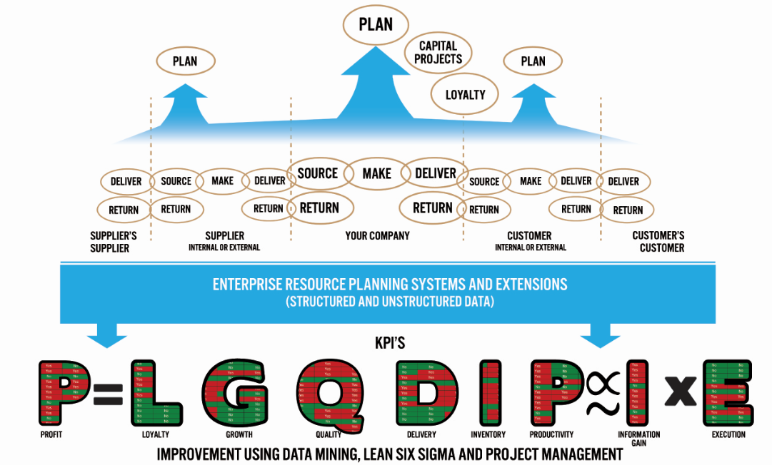
Adding the APICS
SCOR Dimension
Big Data

Slide 50
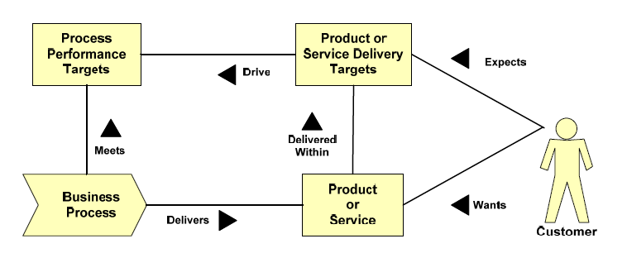
Adding the ABPMP Perspective

Slide 51
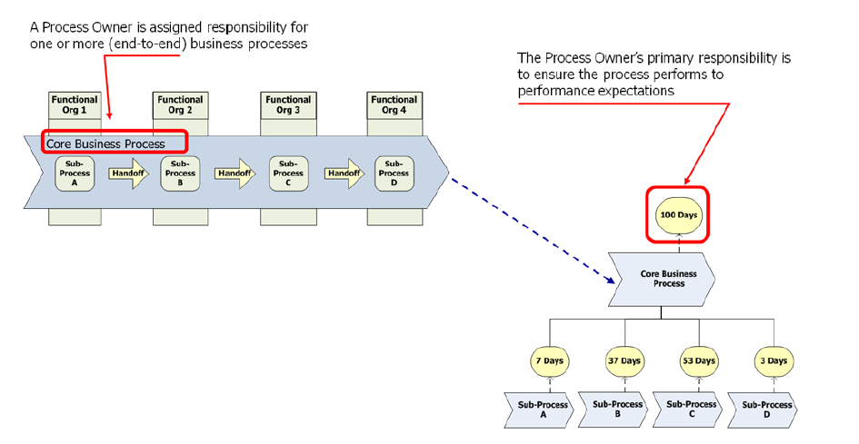

Slide 52
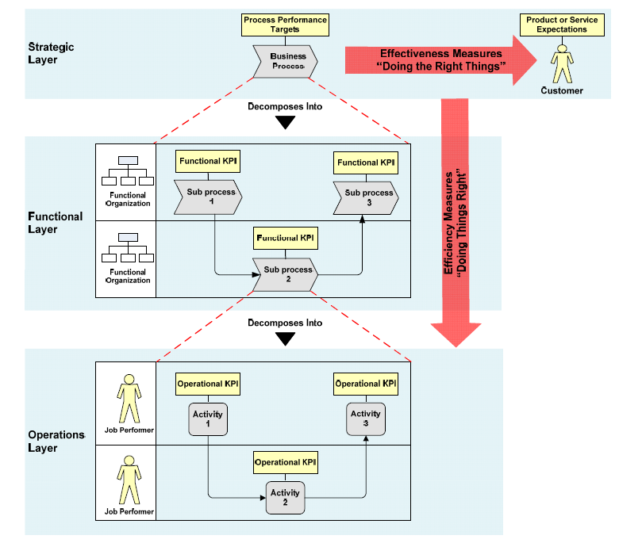

Slide 53
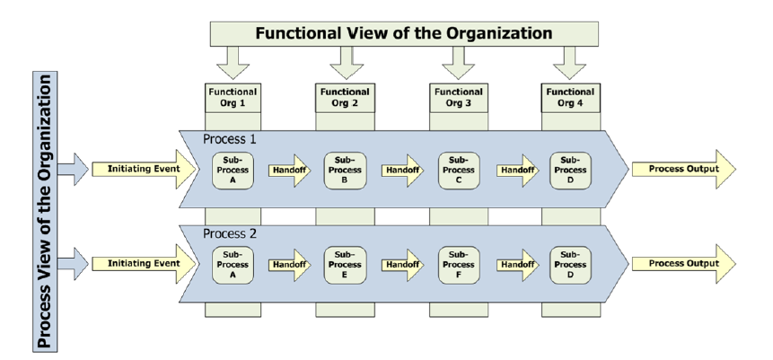

Slide 54
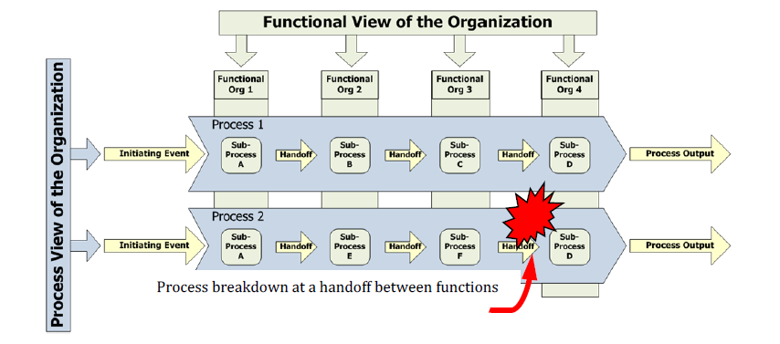

Slide 55
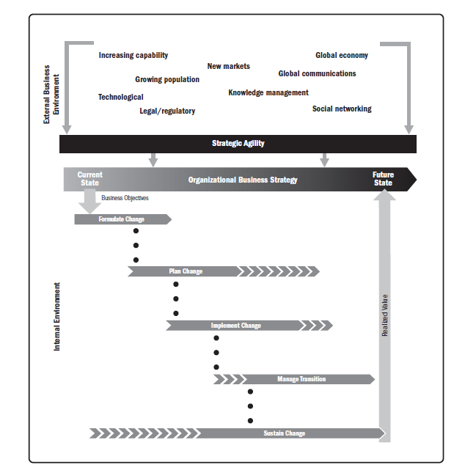
In this course we emphasized the CRISP-DM Project Management Methodology To Help Implement Change Effectively
People
Process
Technology

Slide 56
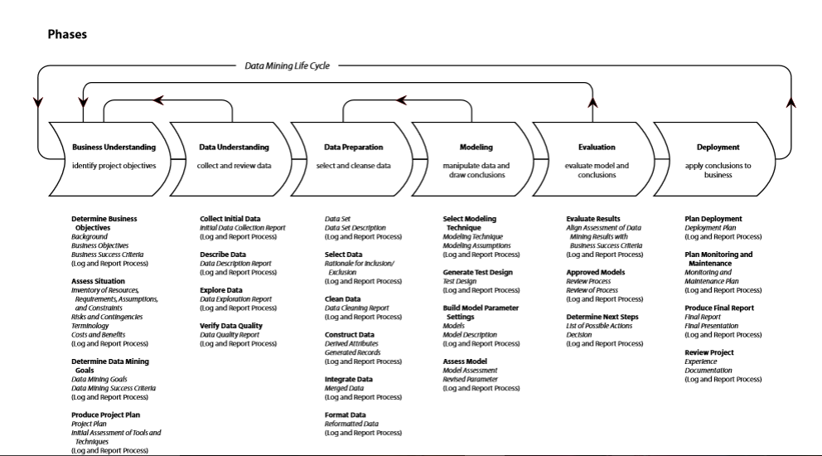
The CRISP-DM Project Methodology

Slide 57


